Slide 1


TOEFL

Slide 2



When to Start?
NOW !!
First / Second year students: General English Skills
Third / Fourth year students: TOEFL Test Technics
TV Series…?!

Slide 3
Exam Structure
Reading
3 passages (continuous 60 minutes)
52 questions (not all questions are equal)
Listening
2 sections (separate 10 minutes, only for answering)
1 conversation (5 questions)
2 lectures (6 questions each)
Extended!!!

Slide 4
Exam Structure
Speaking
6 questions (specific timing for each question)
1 Self Opinion (15 sec, 45 sec)
1 Self Preference (15 sec, 45 sec)
1 Reading + Conversation (30 sec, 60 sec)
1 Reading + Lecture (30 sec, 60 sec)
1 Conversation + Self Recommendation (20 sec, 60 sec)
1 Lecture (20 sec, 60 sec)

Slide 5
Exam Structure
Writing
2 sections
1 Integrated Writing (150 -225 words in 20 minutes)
1 independent Writing (at least 300 words in 30 minutes)

Slide 6
How to study (Vocabulary)
There are words, you HAVE to know…
Essential Words for the TOEFL
504 Absolutely Essential Words
There are words, you’d better know…
Vocabulary used in passages you read (Reading subjects are repetitive!!!!)

Slide 7
How to study (Books)
Delta’s Key to the Next Generation TOEFL Test
Longman Preparation Course for the TOEFL Test
Barron’s TOEFL iBT
Cambridge Preparation for the TOEFL Test
Kaplan TOEFL iBT
Oxford preparation course for the TOEFL iBT Exam
Official Guide to the TOEFL Test
…

Slide 8
How to study (Reading)
Practice
English articles
Magazines (National geography, …)
Documentaries
Figure out your OWN technic
Paragraph by paragraph?!
Question by Question?!
Time Matters!

Slide 9
How to study (Listening)
Practice
TED Talks
TV Series, Movies, …
Note Taking, Note Taking, Note Taking, …

Slide 10
How to study (Speaking)
NOTEFULL videos are a good starting point!
Use template structures and Try to improve them
Use better vocabulary
Enhance the grammar structure!
Record your voice and listen to it
You can detect your errors your self
Don’t think about Truthful answers! You’ve got only 15 seconds to think!

Slide 11
How to study (Writing)
Start with NOTEFULL
Practice real TOEFL samples
ETS has 500 sample topics (irrelevant topics are included)
Use the help of a professional
Template structures can be used (Task1)
Write 300+ words for integrated, 420+ for independent
GRAMMAR, GRAMMAR! Here is where they evaluate this!

Slide 12
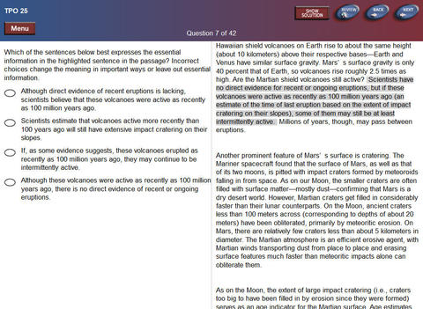
Wrap Up With TPOs!
Real TOEFL tests!

Slide 13
Test Centers
Tehran Institute of Technology (Dibagaran Tehran)
Amirbahador Educational Complex
Tehran Institute of Technology
NOET
Allameh Sokhan

Slide 14
Registration
Two options:
Credit, Master, Visa Cards
Voucher
Take the test ASAP!!!!
On-peak (September to November)
Off-peak (Other times)

Slide 15
Notes
Use your own address in the registration
Average of 2 months for preparation
It depends on your English background
Some studied for 5 days, some for several months
Reading, Listening, Speaking, and Writing topics are repetitive!!!!!

Slide 16
Most Important Note
Test taking skills are much more important than English background!!!!!!!

Slide 17
Thanks for your attention

